Slide 1
Dose Quantities Review
Physics Resident Rotation 1

Slide 2
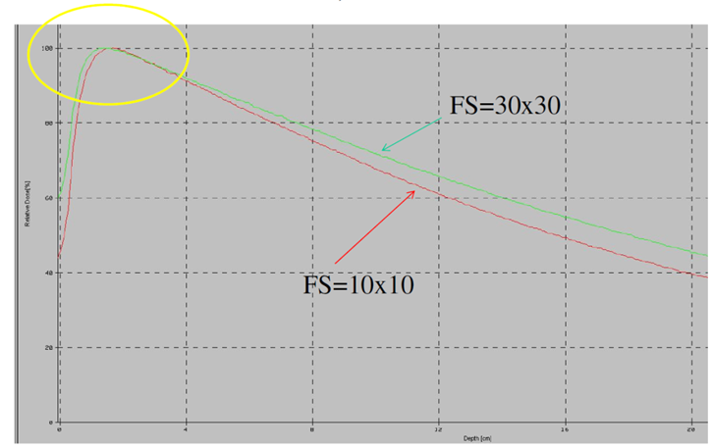
Please explain how PDD changes with FS.
Notes:
PDD and Surface Dose ↑ as FS ↑
D_{max} ↓ as FS ↑
Increased scatter contribution

Slide 3
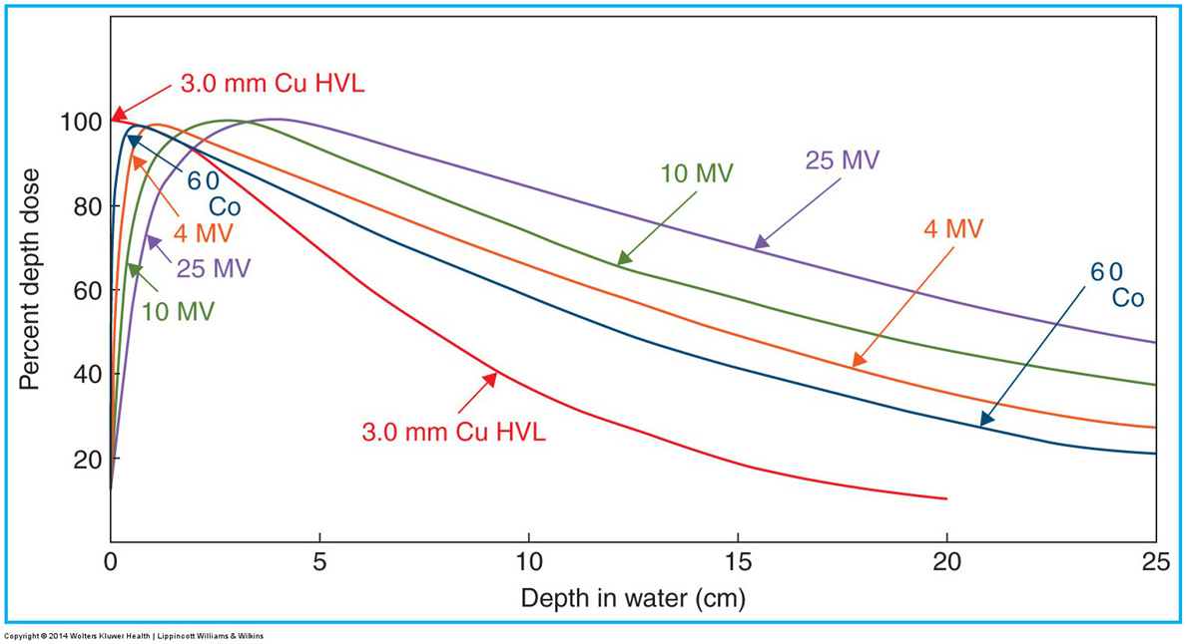
Please explain how PDD changes with Energy.

Slide 4
Typical Values
What is Dmax for 6X, 10X, 15X for a photon PDD? ~1.5, 2.5, 3
What is the PDD at 10 cm for a 6X photon beam? 0.67
TMR? 0.8
Surface Dose for 6X photon, 18X? 30% (6X), 20% (18X)
Typical penumbra for 6X photon? 0.7cm
What are the rules of thumb for percent decrease per cm?
6X
10X
18X
3%/cm, 2.5%/cm, 2%/cm
Notes:
solutions in white text

Slide 5
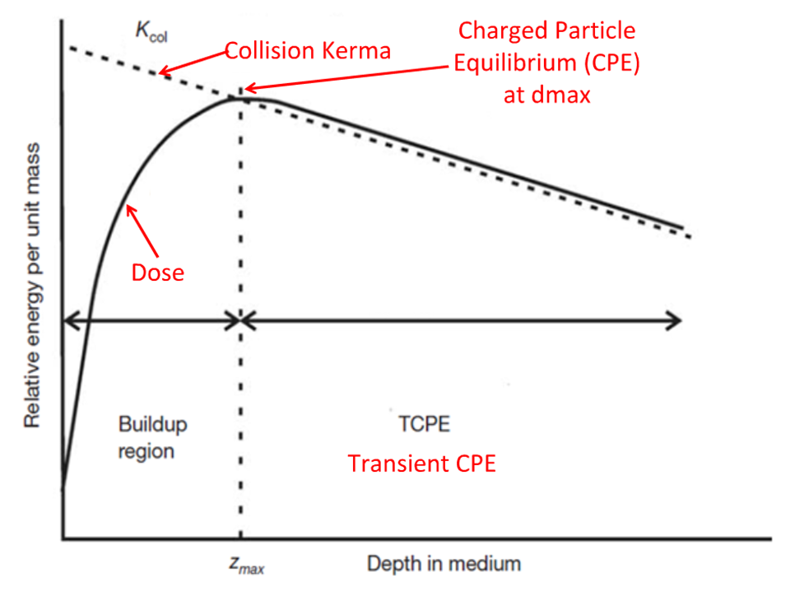
Explain the difference between Dose and Kerma.

Slide 6
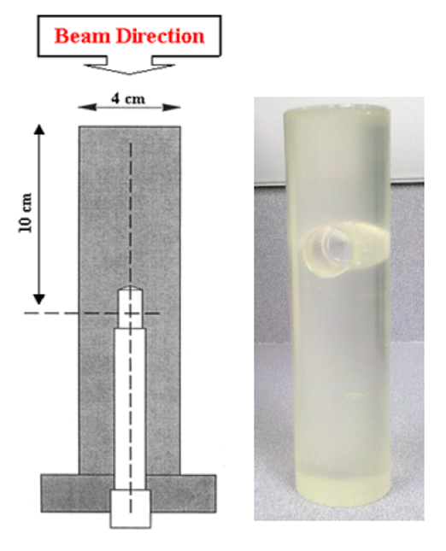
Please explain this device and its purpose.
Notes:
Collimator Scatter Factor: Ratio of the output in air for a given field to that for ref field
Sufficient cross section = lateral scatter equilibrium
Sufficient thickness = make electron contamination negligible
FS large enough to cover phantom

